Slide 1
Lecture 11
Hash Tables

Slide 2
Main Points
Introduction
Hash Table, Hash Function, Collisions
Handling Collisions
Exercise

Slide 3
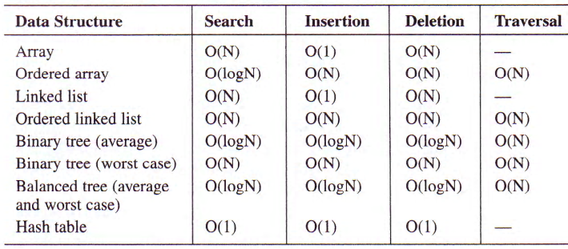
Let’s Look at this

Slide 4
Hash Tables: An introduction
Goal: Is it possible to design a search of O(1): a constant search time no mater where the element is located in the list
Example: Consider a list of employees in a small company. Each of 100 employees has an ID number in the range 0-99. If we store the elements( employee records) in the array, then each employee’s ID number will be an index to the array element where record will be stored
There is a one to one correspondence between the element key and the array index
What about if the company want to use a 5 digit ID number as the primary key.
Compare the size of the array with the number of employees

Slide 5
One solution to the previous problem
What if we keep the array size down to the size that we will actually be using (100 elements) and we use just the last two digits of key to identify each employee?
For example the employee with the key number 45678 will be stored in the element of the array with index 78 and employee with 23456 will be stored in array index 56
We are looking for a way to convert a 5 digit number into a two digit array index: some function need to do the transformation: a hash function to use a hash table (array)

Slide 6
Hash Table, Hash Function, Collisions
A Hash Table is a data structure in which keys are mapped to array positions by a hash function
A Hash Function, is a function which, when applied to the key, produces an integer which can be used as an address (index) in the hash table
For our previous example:
int HashFunction (int id_number){
return( id_number % table_size);
}

Slide 7
Hash Table, Hash Function, Collisions: continue…
Suppose that the hash table contains records of two employees with IDs 45678 and 23456 respectively.
We need to add another employee whose ID is 34878!!
The array element with index 78 has already a value.
When more than one element tries to occupy the same array position, we have a collision
Collision is a condition resulting when two or more keys produce the same hash location

Slide 8
Issues surrounding Hashing
Which HF to use?
The Big Challenge
Easy to compute. If the ‘Hash Algorithm’ is too inefficient it will overshadow the advantages of the technique
Should distribute entries uniformly through the HT slots
Should minimize Collisions
Can we avoid collisions?
No - Collisions are inherent!  Regardless of the type of the HF, we will likely experience collisions because the domain of keys is usually larger than the number of buckets

Slide 9
Other examples
Implementing a Dictionary:
HF: Sum the ASCII codes for the letters then mod n (n is HT size!)
raw and war would have the same key!
How to implement a ‘Spelling Checker’?
Create a HT for all the words in a dictionary
When you encounter a word, whose spelling you want to check, just hash it and see if it exists in the table.
If it does, then you've spelled it correctly.
If not, then you haven't.
This allows you to look up a word in O(1) time rather than O(n) time, which, in a dictionary on the order of 800,000 words, is a big time saver.
Cryptography: Use a hash function to encrypt your passwords

Slide 10
Hash Function: Examples
HFs generally take records whose key values come from a large range, and stores those records in a HT with a relatively small number of slots – Depends a lot of the keys set
Some HF Examples:
Division
F(x) = x mod m; best value for m is prime
Mid-Square:
Middle K digits in X²
Folding:
Given a key x₁x₂… x_{r}
F1(x₁x₂… x_{r}) = x₁x₂+ x₃x₄…+ x_{r-1}x_{r}
F2(x₁x₂… x_{r}) = x₂x₁+ x₄x₃…+ x_{r}x_{r-1}
Example: x = 251367
F1(X) = 25 + 13 + 67 = 125
F2(X) = 52 + 31 + 76 = 159
Truncating:
F(x) = last K digits of x or first K digits

Slide 11
Summarize what we learnt so far….
To add/retrieve an element from the hash table:
Algorithm to add:
Add (key, value){
Index=hash(key);
hashTable[Index]=value;
}
Will these algorithms always work? We can make them work if we know all possible search keys, appropriate Table size and perfect hash function
Algorithm to get a value:
dataT getValue(key){
Index=hash(key);
return(hashTable[index])
}

Slide 12
Collision, Handling Collision
The two ways of dealing with collisions are:
Chaining: use linked list
Open Addressing: Linear probing, Quadratic probing, and Double Hashing

Slide 13
Problem
Consider the following Hash table and the following hash function:
H(x)=x² % 10
What we want is to insert [1,9]
4 Collisions! Because of the hash
function
0
1 | 1,9
2
3
4 | 2,8
5 | 5
6 | 4,6
7
8
9 | 3,7

Slide 14
Solution 1: Use Separate Chaining
Colliding records are chained together in separate linked lists
HT slots don’t hold data, rather it stores pointers to the synonyms’ linked lists.
If a collision happens, insert in the corresponding linked list - O(1). (Insert always at the head)
Search/Delete ?
Drawback: Use of another Data Structure, Linear search through the Linked Lists

Slide 15
Advantages of Separate chaining
Simple collision handling
No Overflow: we can store more elements than the hash table size
Deletion is done from the linked list

Slide 16
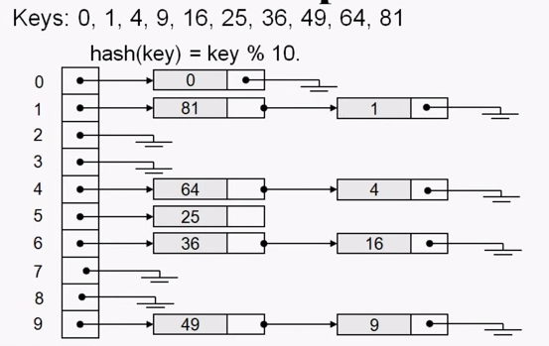
Example

Slide 17
Separate Chaining an illustration
Assume that we want to a list of students into a hash table using their IDs. The following program represent how collision is solved using separate chaining.

Slide 18
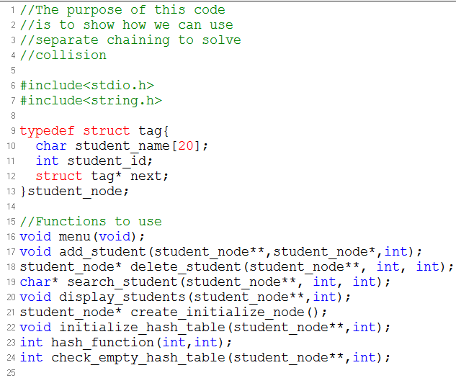

Slide 19
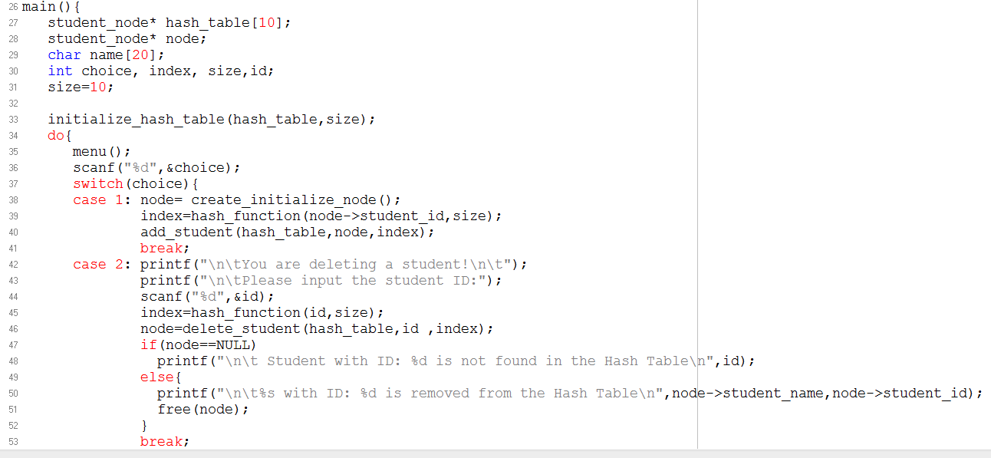

Slide 20
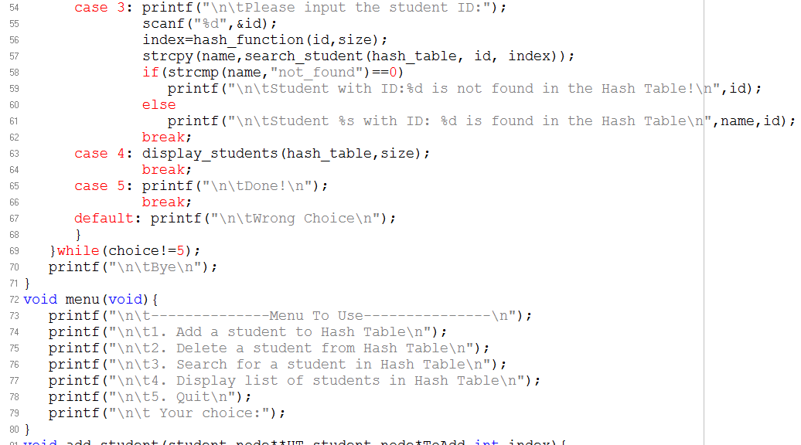

Slide 21
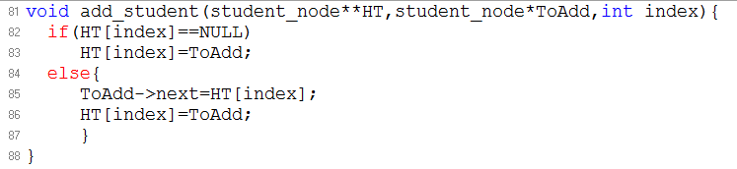
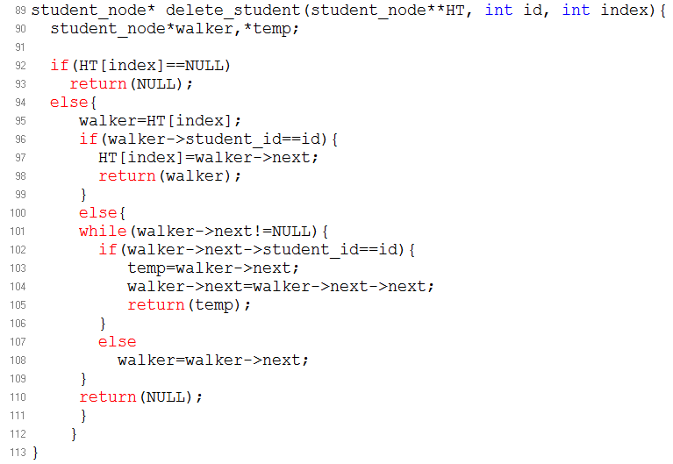

Slide 22
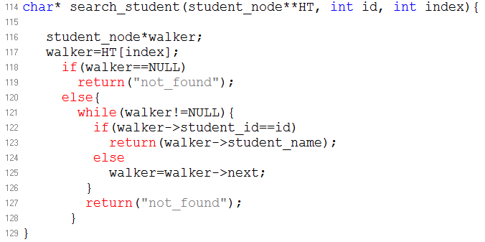
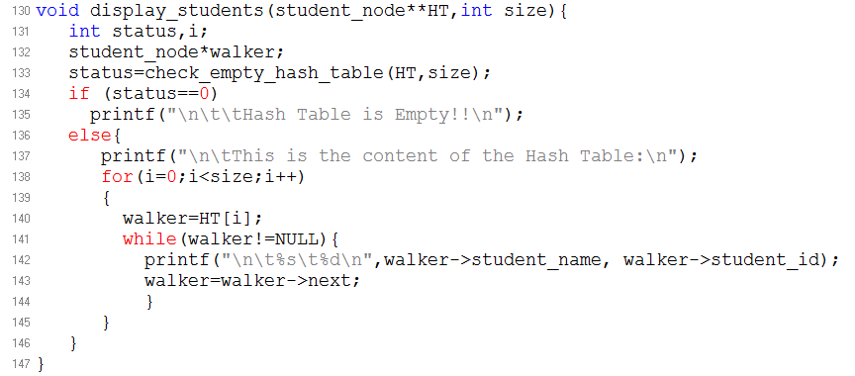

Slide 23
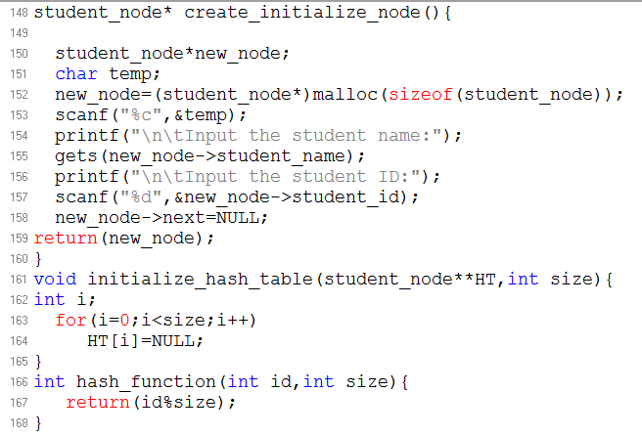

Slide 24
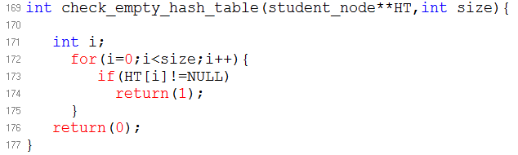

Slide 25
Solution 2: Open addressing
All data go inside the table itself
Works when load factor is below 0.5
Load factor?? In next slides
If a collision happens
Alternative cells are tried till and empty cell is found.

Slide 26
Open Addressing
No linked lists – All items are stored in the same HT
Alternative cells ( h₀(k), h₁(k), .., h_{n}(k)) are tried till an empty cell is found. Each try is called a Probe
h_{i}(k) = hash(k) + f_{i}(k)
The function f_{i}(k) is the collision resolution strategy
Since each cell in the HT can hold only one item. A bigger table is needed than in chaining
Generally, HT Size >= 2N
Several Methods:
Linear Probing
Quadratic Probing
Double Hashing

Slide 27
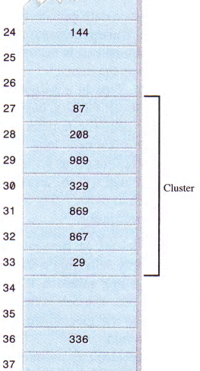
Linear Probing
In this method, f_{i}(k) is linear = i
Linear probing Insert algorithm:
If(table is full): error
probe=h(k)
While(table[probe] occupied)
probe=(probe+1) mod m
Table[probe]=k
Search(k) Algorithm:
Compute h(k)
Look at HT[h(k)]:
If empty (element does not exist)
If full:
Compare to K, if equal return it else:
Loop/’circular linear search’ through successive slots
If found return it
If an empty slot found, element does not exist
Drawback  Clustering
Elements tend to cluster around full slots! Hence, resulting in very long probes. A Solution  Quadratic Probing

Slide 28
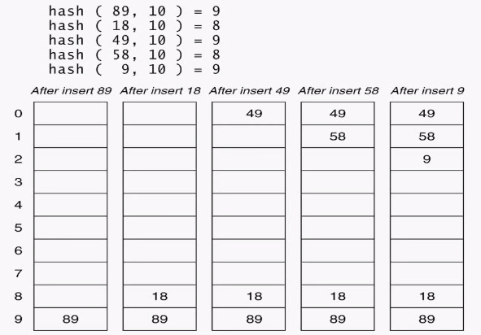
Consider the following example
H(x)= x%10
F(i)=i
-Find 58(#tries?)
Insert 19
Find 19(#tries?)

Slide 29
Linear probing: drawbacks
As long as the table is big enough, an empty cell can always be found but the time to do so can get quite large
More, even if the table is relatively empty, blocks of occupied cells start forming
Primary clustering

Slide 30
Linear Searching Analysis
We want to compute the average probes for a successful and unsuccessful search for this hash
table
H(x)= x mod 11
Case 1: Successful Search
20,30,2,13,25,24,10,9
Avg=(1+1+1+2+2+4+1+3)/8=15/8
(<2: two search/each)
Case 2: Unsuccessful Search
we are searching for: 0,1,2,3,4,5,6,7,8,9,10
Avg=(2+1+1+4+3+2+1+1+5+3+1)/11=24/11
0 | 9
1
2 | 2
3 | 13
4 | 25
5 | 24
6
7
8 | 30
9 | 20
10 | 10

Slide 31
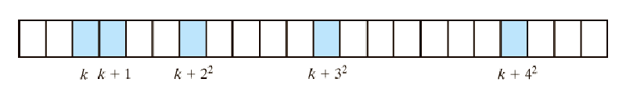
Solution 3: Quadratic Probing
Eliminates Clustering by probing separated slots
f_{i}(k) is linear = i²
If collision happens at HT[k], look successively at K+1², K+2², … till empty cell found
Theorem: Guarantees finding an empty slot - if any – when the array size is prime
Solves the ‘Clustering’ BUT can lead to ‘Secondary Clustering’:
I.e, Colliding Elements will try the same probes

Slide 32
Example
H(x)=x mod 10
Insert: 3,5,13,24,33,45,54
54?
0
1
2
3 | 3
4 | 13
5 | 5
6 | 45
7 | 33
8 | 24
9

Slide 33
Solution 4: Double Hashing
Avoids both Primary and Secondary Clustering
Idea:
The probe should depend on the key instead of being the same for all keys
Use another Hash Function. Hence, the increment is defined by second function
The Second HF should:
Depend on the key
Be different from the first! Why?
Not returning Zero

Slide 34
Double Hashing Insert Algorithm
If (table is full) error
probe=h1(key), offset=h2(k)
While(table[probe] is occupied)
probe=(probe+offset) mod m
Table[probe]=k
The probe goes to probe, probe+offset, probe+2*offset, probe+3*offset…..

Slide 35
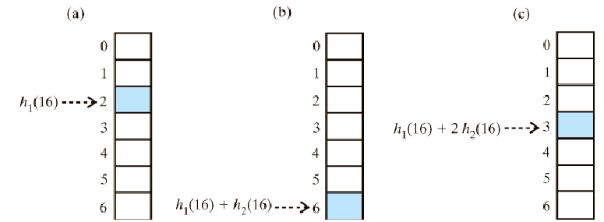
Double Hashing (Cont.)
Ideal functions are of this format:
h₂(Key) = Const – (Key % Const)
Where Const is a prime number less than HT size
Example: (Const = 5)

Slide 36
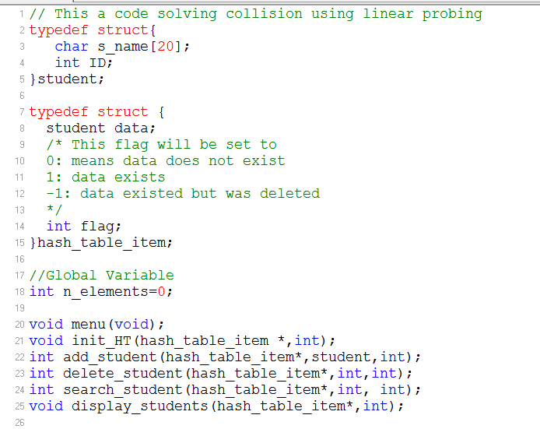
Illustration of linear probing

Slide 37
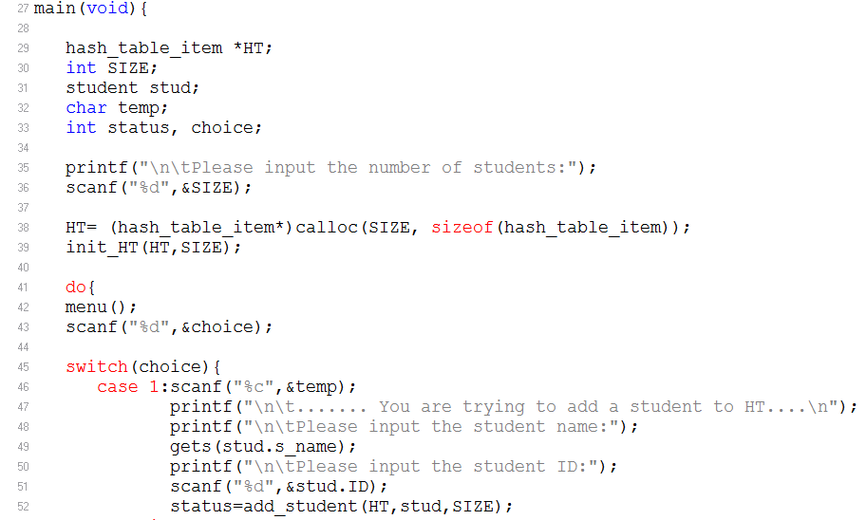

Slide 38
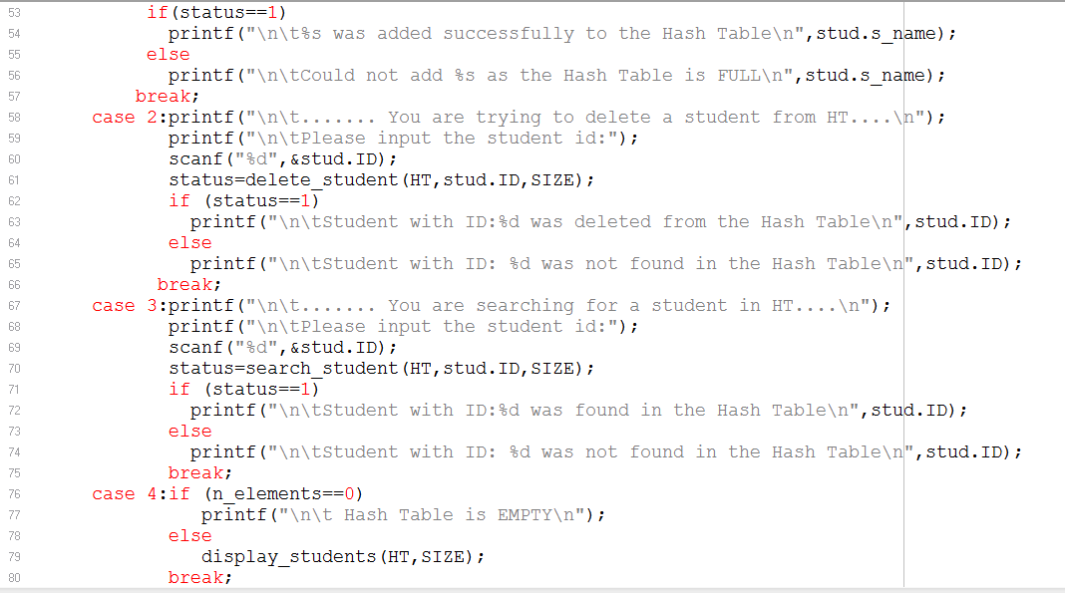

Slide 39
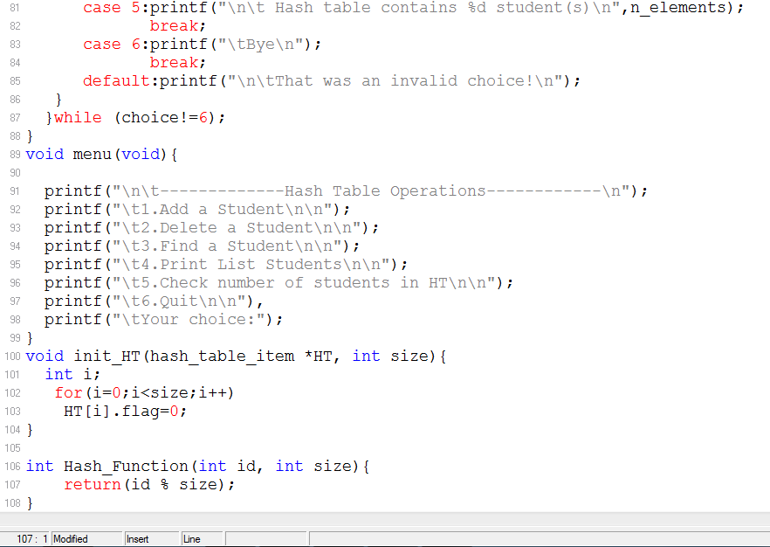

Slide 40
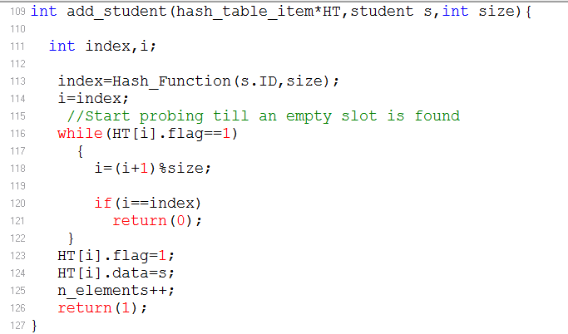
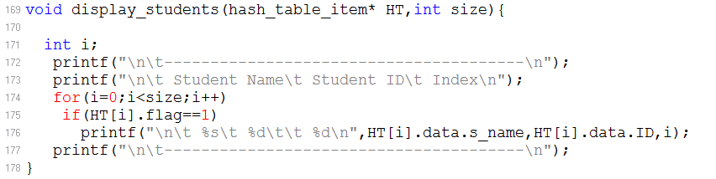

Slide 41
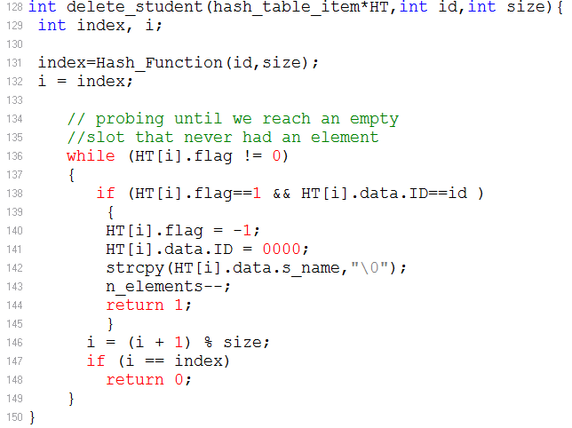

Slide 42
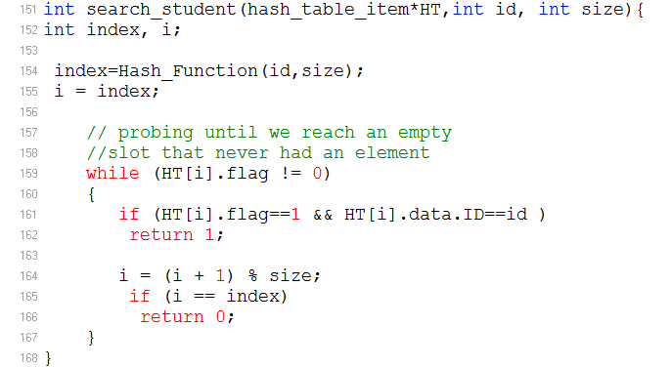

Slide 43
Illustration of Double Hashing
Important points to consider:
Ideal functions are of this format:
h₂(Key) = Const – (Key % Const)
Where Const is a prime number less than HT size
When you refer to the code, you will find a function used to get the prime number

Slide 44
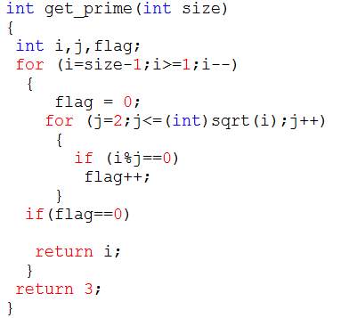
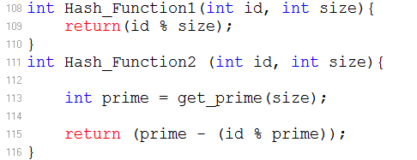
Function to find prime to use in the second hash function

Slide 45
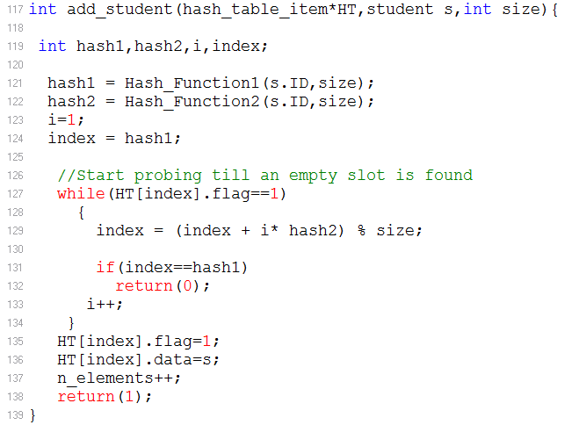
Insert an element to HT

Slide 46
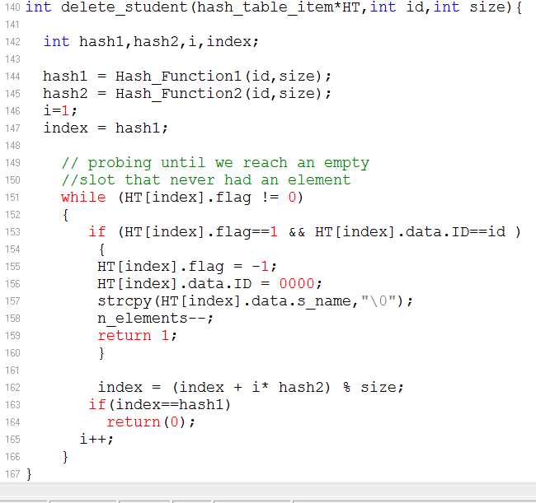
Delete an element from HT

Slide 47
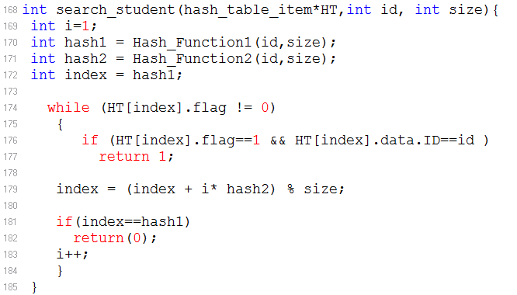
Search for an element in the HT

Slide 48
Load Factor and Hash Tables

Slide 49
Analysis of Separate Chaining
Load factor λ definition:
Ratio of number elements (N) in a hash table to hash table size
i.e: λ= N/TableSize
The average length of a list is also λ
For chaining λ is not bound by 1, it can be >1 (Hash Table size is 10 but N=100)
So to delete/search an element: time to compute hash function + length of the chain: λ so search and delete: O(1+λ)=O(λ)

Slide 50
Hash Tables: A Summary
A hash table is based on an array
The range of key values is usually greater than the size of the array
A key value is hashed to an array index by a hash function
The hashing of a key to an already filled cell is called a collision
Collision can be handled using open addressing or separate chaining
In open addressing, data items that hash to a full array cell are placed in another cell in the array
In separate chaining, each array element consist of a linked list

Slide 51
Hash Tables: A Summary
In linear probing the step size is always 1
The number of tries required to find an item is called the probe length
In linear probing, contiguous sequence of filled cells appear: primary cluster
Quadratic probing eliminates primary clustering but suffers from less severe secondary clustering
In double hashing the step depends on the key and is obtained from a second hash function

